Slide 1
Smart Touchless Control with Millimeter-Wave Radar Sensor and Artificial Intelligence
DIP: AY2122s1 - E047
Supervisor: Prof LU YiLong
25 Aug 2021

Slide 2
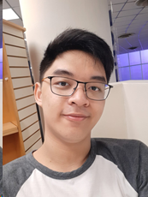
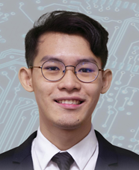
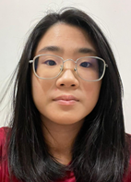
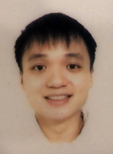
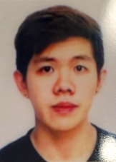
0. Students & Plan
Group Leader: Philip Lee Hann Yung
Treasurer: Thum Yi Wen
Sub-group 1: Acconeer 112
Sub-group 2: Acconeer 122
Photo | photo | photo | photo | photo
PHILIP LEE HANN YUNG | LEE WAI YEONG | THUM YI WEN | TAN WEN HAN DAVIS | GOH JUN DE
PLEE016@e.ntu.edu.sg | WLEE086@e.ntu.edu.sg | THUM0010@e.ntu.edu.sg | DTAN118@e.ntu.edu.sg | JGOH117@e.ntu.edu.sg
94708875 | 81304199 | 84258300 | 83498287 | 90096863

Slide 3
Plan & Schedule
Plan & Schedule
Tasks | Week
 | 1 | 2 | 3 | 4 | 5 | 6 | 7 | 8 | 9 | 10 | 11 | 12 | 13
Background information and theory
Purchasing radar sensor and Rasbery Pi
Sample radar signal/data processing in Matlab
Sample ML processing in Matlab
Radar signal/data processing in Rasbery Pi
ML processing in Rasbery Pi
Integration and Testing

Slide 4
Week 1 Updates
Nomination of the Group Leader and Treasurer. The subgroups will be discussed further when we meet up next week.
Familiarize ourselves with the material that Prof Lu has kindly provided us including but not limited to MATLAB, Python on Raspberry Pi, STFT and Chloe’s FYP report.
Research about the Acconeer radar sensor and Raspberry Pi and place an order by Week 3/2 latest.

Slide 5
Week 2 Updates
Completed the lab safety modules and then discussed the devices to buy – eventually settling for XB112 & XB122 Acconeer Radar Sensor modules, Raspberry Pi 3 Model B+ and 4 Model B 8 GB RAM, 64 GB micro SD card, and some cables/wires for the devices.
The sample codes were also shared and we learned how to use GitHub to share our files with the whole team.
Prof Lu provided us with an Acconeer XB112 Module to experiment with.
Within the week, we placed the orders and hope that the hardware will arrive by our next meeting. We also plan to have a look at the SDK provided by Acconeer to explore the features of the sensor.

Slide 6
Week 3: Received Ordered Items
Received orders #1 to #5
Supplier | Product | Uni Price | Quantity | Cost | Receipt Total | Order
Digi-key | Acconeer XM112 | 94.13 | 1 | 94.13
 | Acconeer XB112 | 105.84 | 1 | 105.84 | 199.97 | 1
Digi-key | Acconeer XM122 | 49.8 | 1 | 49.80
 | Acconeer XB122 | 136.38 | 1 | 136.38
 | Acconeer XA122 | 23.88 | 1 | 23.88 | 210.06 | 2
Cytron | Rasberry Pi 4B (8GB) | 119.99 | 1 | 119.99 | 119.99 | 3
Cytron | Rasberry Pi 3B+ | 57.86 | 1 | 57.86
 | Raspberry Pi Universal Power Supply 5.1V 2.5A micro B | 16.07 | 1 | 16.07
 | Rpi 15W (5V/3A) PSU USB C UK Plug-White USB c | 12.5 | 1 | 12.50 | 86.43 | 4
Shopee | 64GB microSD card | 18.9 | 2 | 37.80 | 37.80 | 5
 |  |  | Total | 654.25

Slide 7
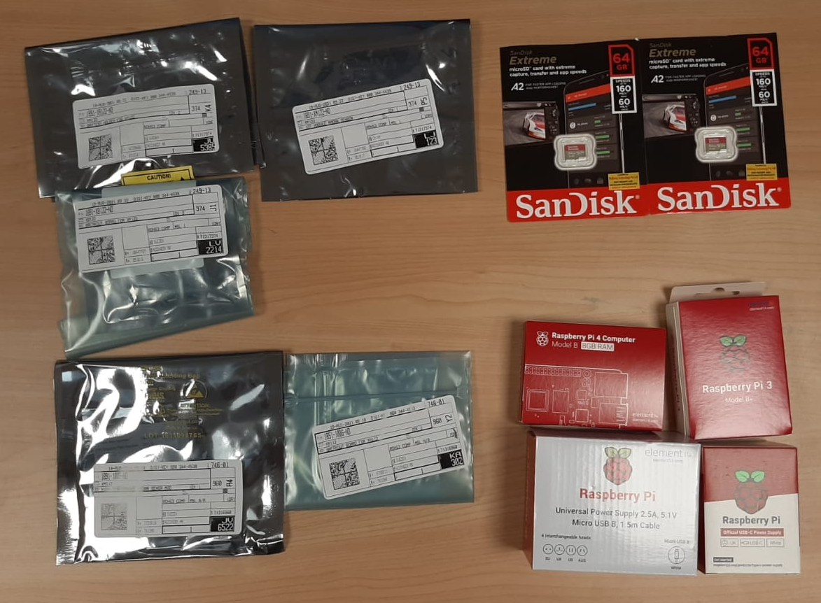
Week 3 Updates

Slide 8
Week 3 Updates
Reading and downloading documentation for the sensors found at https://acconeer-python-exploration.readthedocs.io/en/latest/index.html and the Acconeer developer site.
Before using the sensors, we need to flash a binary file onto the device. During the configuration, we found that only 1 of our member’s laptop was able to interface with the devices and we spent most of the time debugging this.
In the end, it was because we had to install a virtual COM driver so that the radar sensor will be recognized as a serial UART.
Experimenting with the demo application to see the potential use cases and limitations of the radar sensor.
Explore the data that can be collected by the sensor via the h5 file format.

Slide 9
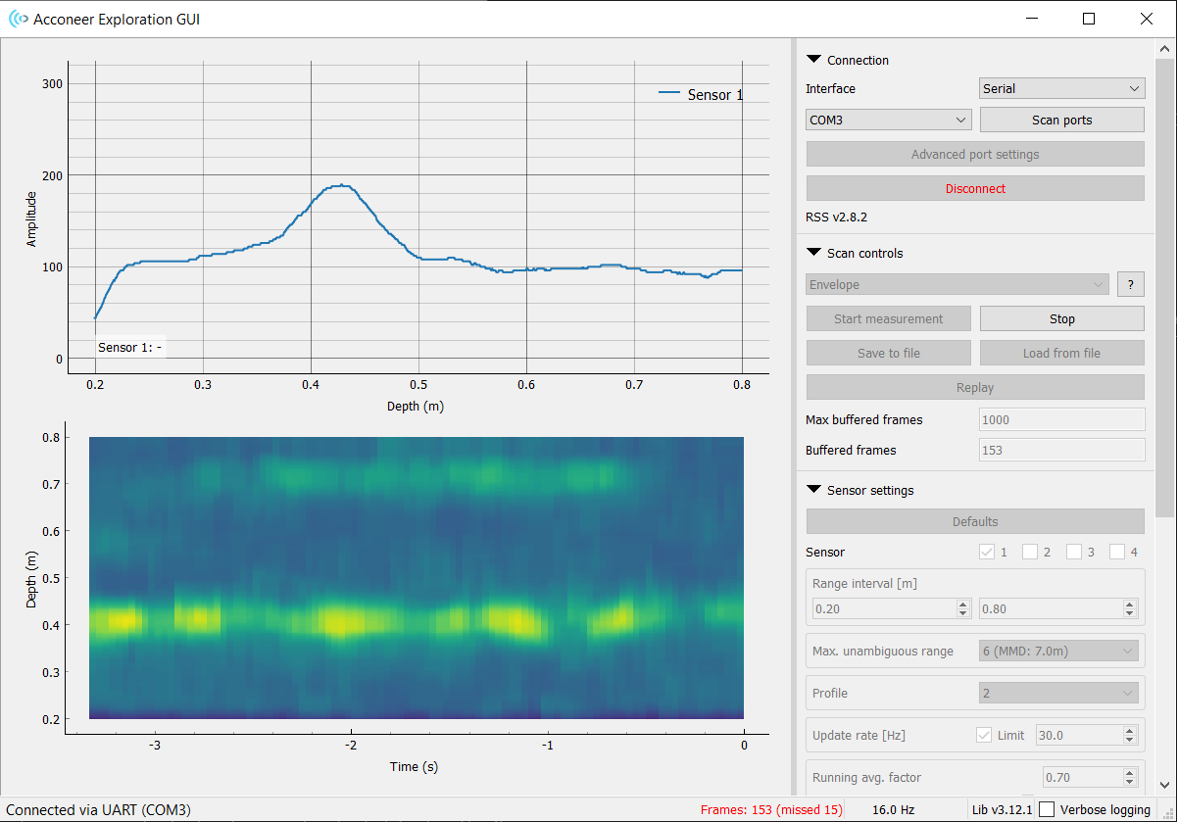
Week 3 Updates

Slide 10
Week 4 Updates
Items we learned/achieved today:
IQ mode: In-phase and quadrature data has the most information so we should extract this as raw data to be processed in MATLAB/Python.
Recorded background data at fixed target distances (wall) of 0.5, 1.0, 1.5, 2.0 m.
To do this week:
Purchase container for sensors (Jun De)
Make a script for h5 reading and STFT to generate signatures in Python (Philip)
Gather sample hand gestures eg. 5 x 3 different gestures and perform STFT to compare results
Read Chloe’s FYP report so we are clear about the theory
Watch https://www.youtube.com/watch?v=0xROkVQ1XWQ or https://www.autosofdallas.com/blog/learn-how-to-use-the-bmw-5-series-gesture-control-feature/ for inspiration for possible hand gestures

Slide 11
Week 4 Updates
Finalized pipeline:
Collect radar sensor data (IQ mode) and export it as h5 file
Parameters: frames 128/256, rate: 30Hz
Process extracted h5 files via Python (code converted from MATLAB)
Perform STFT on processed h5 file and export as png as a signature
Intuition of RGB compressed into a grayscale image
RGB equivalent to depth
Window Size
Image file (png file format) is a numpy array of shape 2
Png file feed into ML Model to perform object classification via sklearn
Implement into Raspberry Pi and integrate into workable product ie volume control, switching on/off

Slide 12
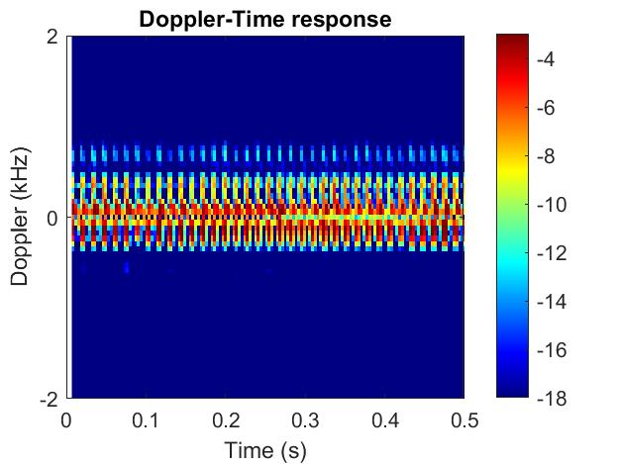
Week 5 Updates
Examined the MATLAB script to see what features does it extract, and started conversion to Python (except one function which has an error).
Obtained data samples to see differences in STFT signatures.
Packaged the sensor hardware into a container for safekeeping.

Slide 13
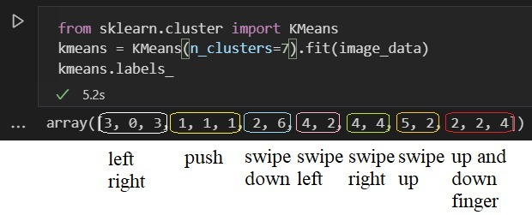
Week 6 Updates
We had gathered some images based on the gestures such as pushing, swiping left, swiping right, swiping left and right, swipe up, swipe down and switching. Based on those data gathered alongside with the help of machine learning we observed that swiping left and right could not be differentiated.

Slide 14
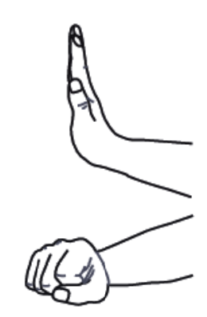
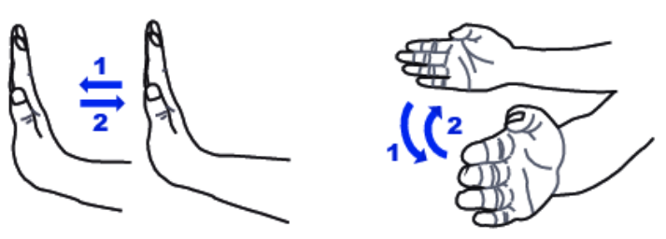
Week 6 Updates
Our team has done some testing on the gestures and had finalized 3 gestures, namely, (i) swiping, (ii) pushing and (iii) opening/closing palm
We are also working on a Python script to implement the pipeline we mentioned. And for systematic and semi-automated data collection for gestures (to prepare for ML pipeline)

Slide 15
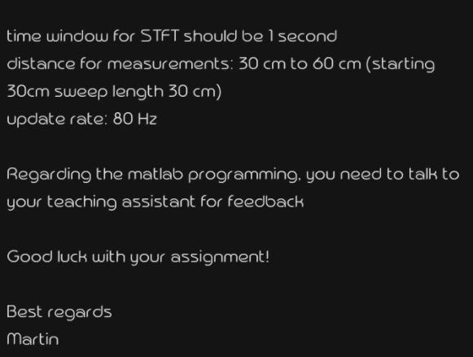
Week 6 Updates
We have asked the relevant department from Acconeer and they had responded the following. We would like to inquire based on the following data that was given on their end, the update rate could be manually tuned on the GUI, but specifically for the time window segment for the STFT where should we change the time window to 1 second.

Slide 16
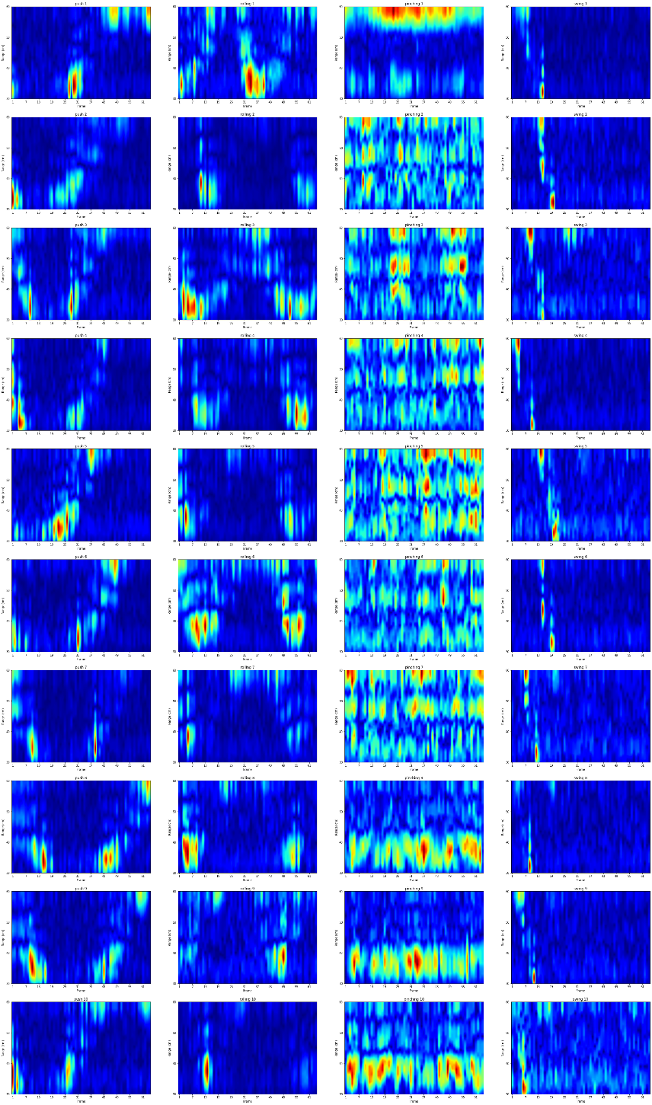
Week 7 Updates
We have finalized the gestures that we will collect after discussing with Prof Lu. A preview of the magnitude plots is on the right, which gives a good indication of whether our data collected is good.
We discovered there were some alignment issues so we made a data sampler tool to help this process (see section 2).

Slide 17
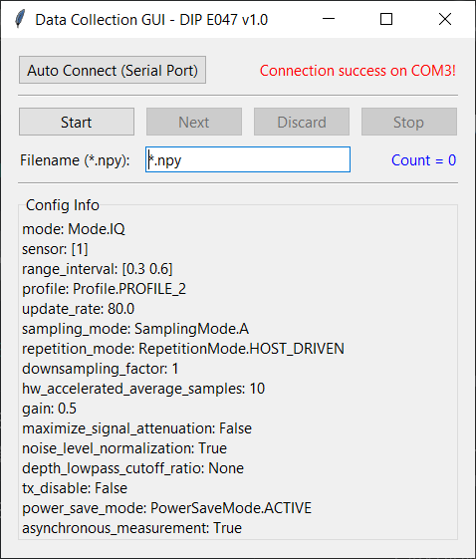
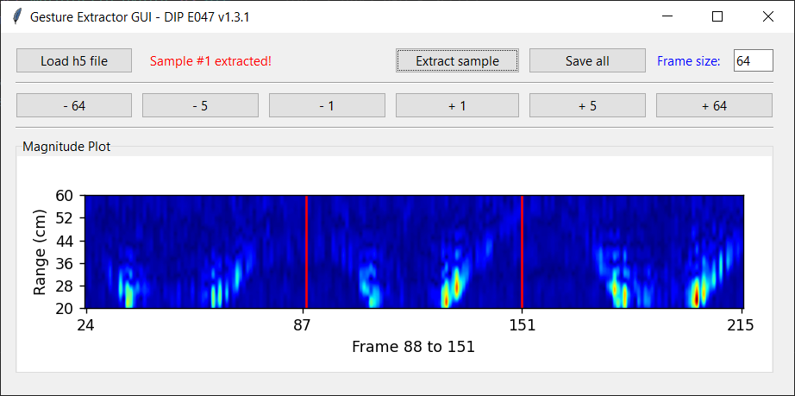
Week 7 Updates
We made a customized Graphical User Interface (GUI) for radar data collection (left) and for gesture extractor (right)
(left) Radar data collection
(right) Gesture extractor

Slide 18
Week 7 Updates
The GUI for gesture extractor loads in a h5 file and enables the user to extract frames containing gestures with a preview from the magnitude plot and by specifying the width and position of each frame.
gui-dip-demo/gesture_extractor_gui.py is a Python script developed to automate the process of extracting gesture samples from a continuous recording obtained from the GUI tool provided by Acconeer. This fixes the alignment issue faced when recording one sample at a time.
The tool saves extracted samples in .npz format with the intention of a small file size. To read data from these new files, please use np.load('filename-000.npz')['sample'], where filename is a placeholder.
For ease of running the tool, an alternative Windows executable file gui-dip-demo/gesture_extractor_gui_v1.3.2.exe is available too.

Slide 19
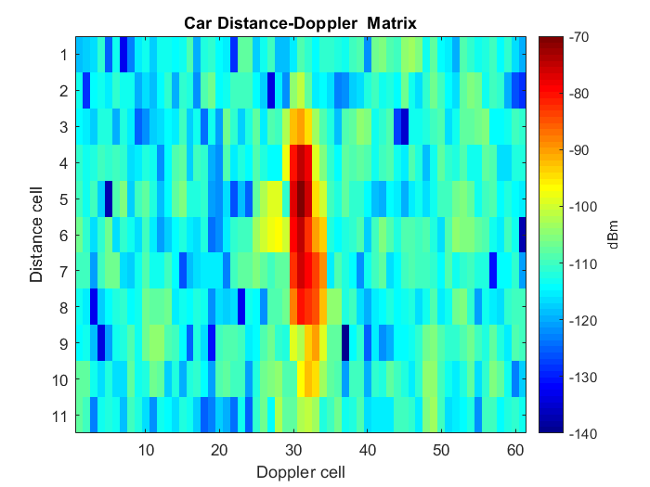
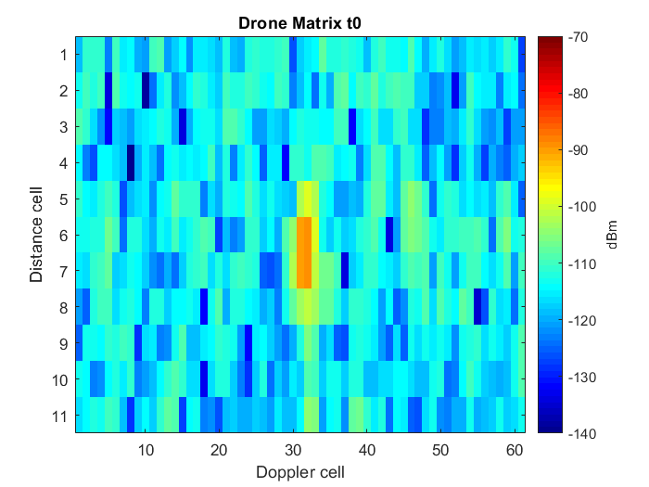
Recess Week Updates
We used a mock radar dataset of cars/drones/people (https://www.kaggle.com/iroldan/real-doppler-raddar-database) to test our machine learning pipeline when we didn’t have enough data.
The diagrams below show examples of Doppler matrices of the mock dataset to be fed into the models.

Slide 20
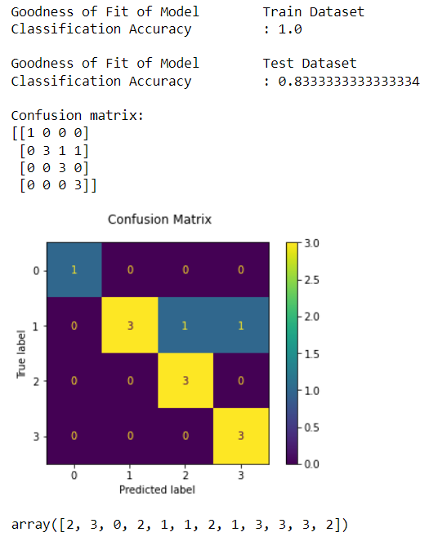
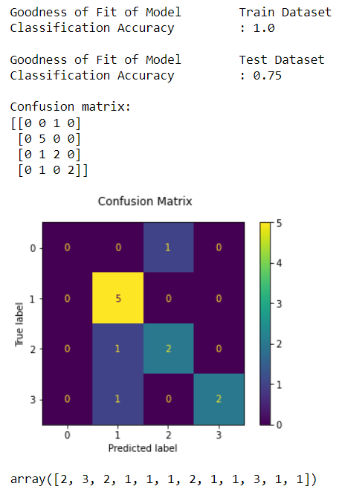
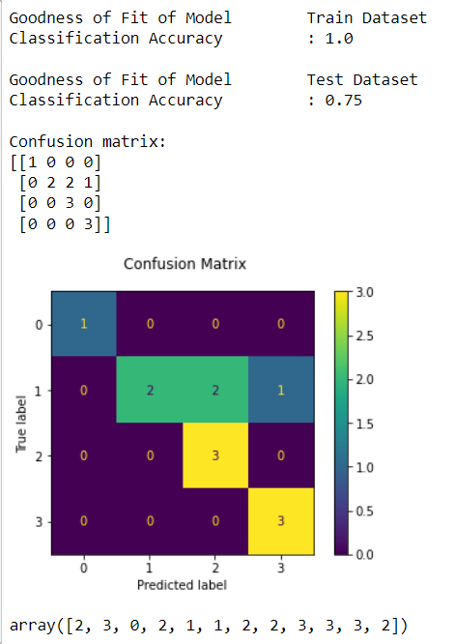
Recess Week Updates
We then implemented the pipeline using our own dataset based on the collected radar data, with a train-test-split ratio of 0.7.
The dataset size consists of 40 magnitude plots of four gestures (10 plots each) (i) pushing, (ii) rolling forward, (iii) pinching, and (iv) swipe left to run some machine learning models such as KNN, linearSVM, logistic regression etc to find out the best model performance.
We found that linear SVM, decision tree and logistic regression model can show good classification results on our radar dataset. Improvement will be done in the subsequent meeting.
(i) LinearSVM model
(ii) Decision Tree model
(iii) Logistic Regression model

Slide 21
Week 8 Updates
Data Collection (1st Round)
During the process of data collection, We had finalised the range interval to be 0.2m - 0.5m. The range was chosen as such is because it can detect proper peaks
During the process, we had tried various different parameters namely adjusting the following. (i) Smoothing factor (0.9) (ii) Down-sampling factor (iii) HW acceleration average samples
One key observation made during the data collection, When the gesture tend to be rapid, the sensor was not able to pick up any peaks, hence we have to slow down our hand gesture in order for the radar to peak up sensible data.
The GUI was used to extract the gestures (~200 samples total).
Real-Time Predictions
The real-time script was also finalised and we compared our ML and deep learning models performance.
Able to connect to the Acconeer sensor directly and make predictions of the gestures. The predictions were printed out every 64 frames, based on our training samples.
The predictions were not reliable so we proceeded to improve based on a data-centric method the following week.

Slide 22
Week 9 Updates
Data Collection
Collected more gesture samples from all members due to insufficient data for the machine learning to detect many other different forms of abnormality/ non-ideal case (e.g. direction of swiping, hand size etc.).
Gathered background data as well for the purpose of better supervision of the learning and not detect any form of gesture when it is not performed.
After many observations from the GUI, the depth of rolling and pushing gestures is very much similar to one another, hence rolling will be removed and pushing will still be one of our primarily gesture.
Raspberry Pi
Managed to connect the RPi to Acconeer radar sensor and display it via VNC Viewer.
RPi3B+ operates using a Static IP address while RPi4 operates via a router
Installed python package dependencies (e.g., tensorflow, opencv, numpy) using pip3.

Slide 23
Week 9 Updates
Issues faced on Raspberry Pi
Librosa/numpy cannot be installed in the raspberry pi model 3B+ via pip3.
Solution
We decided to use Conda which caused a massive destruction and changed the environment path variables.
We needed to temporarily add the correct system path to obtain sudo command privileges, and go into the bashrc file and modify the path variables to uninstall conda from the Raspberry Pi
Final Use Case
We also started ideation and briefly discussed on ways to present our project in a usable case scenario. Each member was to research possible use cases.

Slide 24
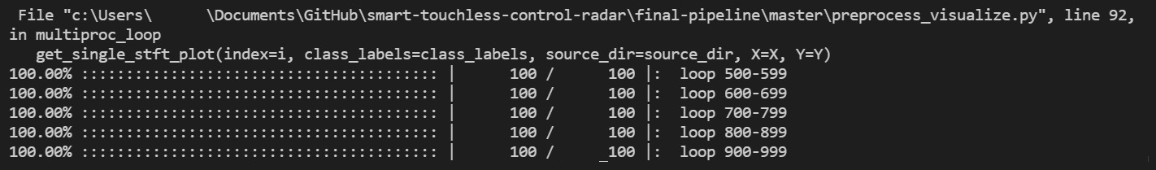
Week 9 Updates
Prediction
Experiment with STFT and MFCC parameters.
Based on the new dataset, we managed to obtain a test accuracy of 80%. Based on this, we tested it real-time too but found disappointing results.
For each gesture sample, an image file was generated for all of the features (i) magnitude, (ii) STFT, (iii) MFCC.
We compared within each gesture class and found that there are many non-distinguishable samples. Hence, we set out a plan to further improve our data collection process

Slide 25
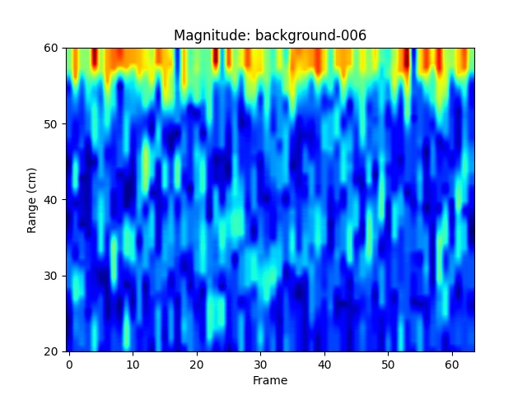
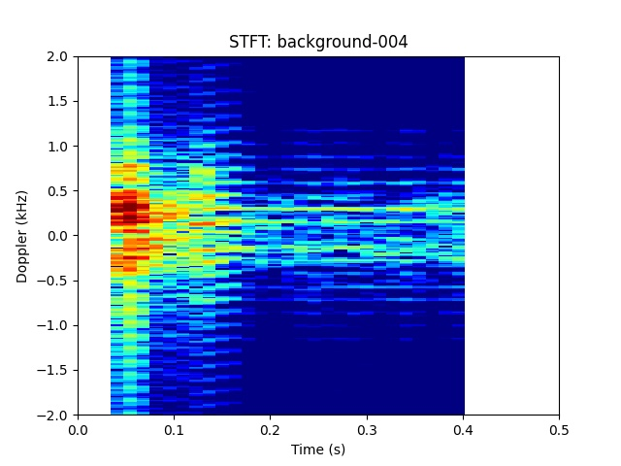
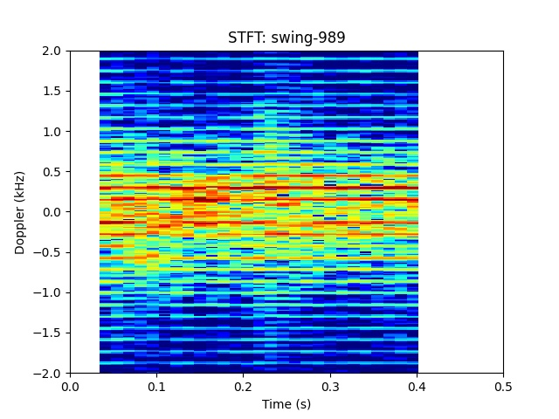
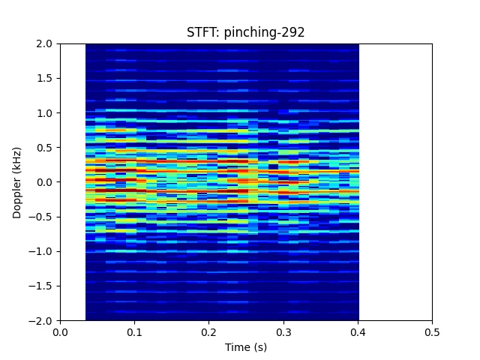
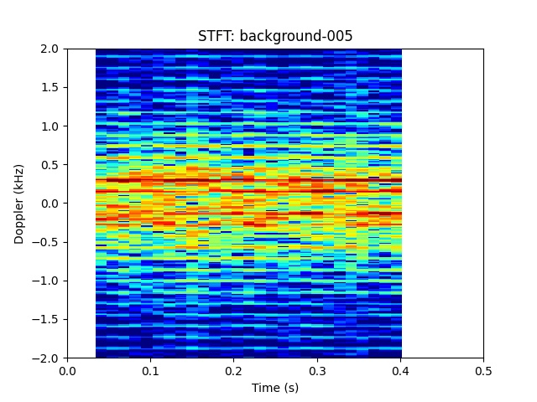
Week 9 Updates
Bad features
Corrupts our dataset!
Spurious peaks near 0.6 m range
Background looks like a gesture
Swing looks like background
Good features
Conclusion:
Our dataset has to be improved!
These gestures are distinguishable!
True pinching STFT
True Background STFT

Slide 26
Week 10 Updates
Data Collection
After analysis of our data last week, we decided to collect ‘cleaner’ data samples. We changed the range back to 0.2 – 0.5 m as there were spurious peaks in the 0.5 to 0.6 m range.
We also changed the gestures again so that we can see their difference distinctly during data analysis. This will help the ML classifier make a sense of the difference of the gestures.
Raspberry Pi
Managed to run the real-time python code on Raspberry Pi. Debugged and fixed some compatibility issues of our script with a Linux system.
We find that our script is not computationally expensive and works well running on the 3B+ model which has lower specs.
We also try to install PyQt5 on the Raspberry Pi so that we may use this for our GUI. The usual pip3 method does not work on the Raspberry Pi as it is a 32-bit ARM architecture.

Slide 27
Week 10 Updates
User Interface
Pitched up some ideas on the User Interface for DIP presentation, which include
Whiteboard, Menu, Games
We will commence discussing further details from Week 11 after our ML model is finalized and performing well.
Prediction Results
We conclude that our dataset is now good as we obtained a 98% accuracy on the test set for the deep learning model using STFT features. Other models also perform around the same accuracy.

Slide 28
Week 11 Updates
Prediction Results
The real-time evaluation only performs well if the gesture is at a particular range and time synchronization.
We discover that there was train data leakage leading to the high accuracy previously.
We tried varying the occurrence time of the gesture within the frame sample but the prediction results were not good and unusable.
Hence, two methods were experimented upon to improve our results and reliability.
Adding a wait time before the gesture is recorded to be sent to the ML pipeline
A voting technique was used to predict k frames before and after the actual frame (total 2k+1 votes)
The Raspberry 3B+ was not usable as it was too slow and caused too much latency in the gesture prediction. The Raspberry 4B and computer had some differences in accuracy, we are still investigating the reasons.

Slide 29
Week 11 Updates
Project Report
We subdivided our portion for the project report and began to work on it.
User Interface
We also start working on a user interface to showcase our project result and use case.

Slide 30
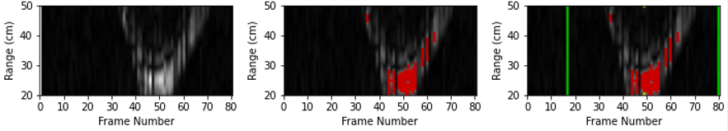
Week 12 Updates
Real-time Robustness
We added a centering algorithm to crop the region of interest from 80 frames to 64 frames
This addition proves to very useful as our prediction results changed from unusable to very satisfactory.
We also performed time analysis on each API function to see which was causing a bad performance on the Raspberry Pi.
After much optimization of the functions and scripts, we find that the entire project is able to run independently on the Raspberry Pi 3B+.

Slide 31
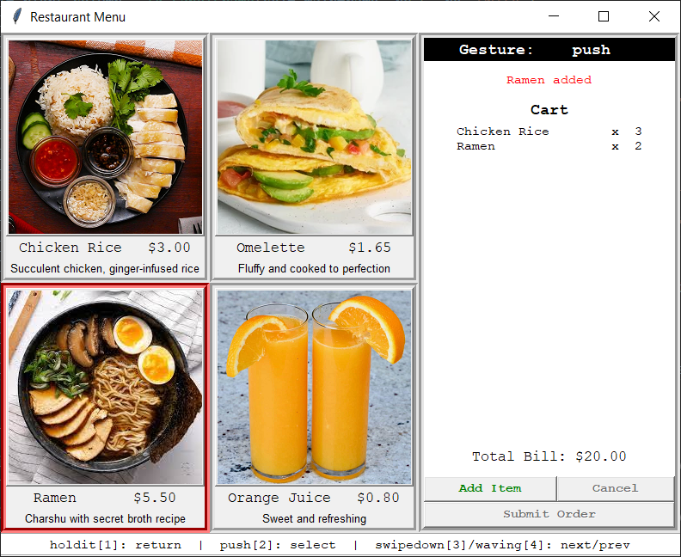
Week 12 Updates
Menu Application
We also made a fully-functional menu ordering application with the gestures key-binded to some key presses on the keyboard.
This serves as a bridge so that the gesture prediction script can interact with the menu in realtime.
We are able to showcase one example and use the gestures to control the actions performed in the menu application. Eg. order, cancel item, place order, scroll menu

Slide 32
Week 12/13 Updates
Week 12: Final Report
We have completed the final report where we discussed in details about our project and findings. Together with discussing soft skills learned like teamwork and communication.
Week 13: Oral Presentation
We discussed mainly on the presentation.
We also recorded some sample demo videos and planned for the live demo + Q/A.

